Slide 1

Git Basics

Slide 2



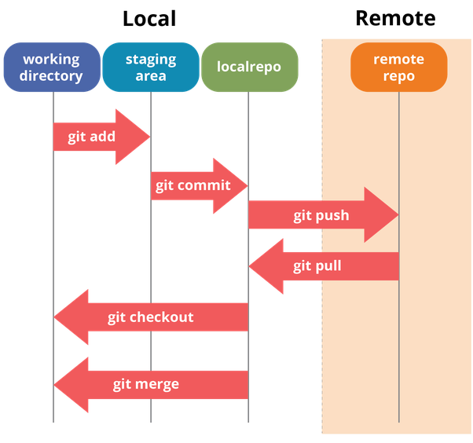
What is Git?
Git is a version control system developed by Linus Torvalds
Originally created for development of Linux
Used to keep track of file changes and coordinating work with multiple people.
Support for non-linear development. Many branches
Handles large projects
Fast and efficient
Compatibility with HTTP, FTP, or SSH

Slide 3
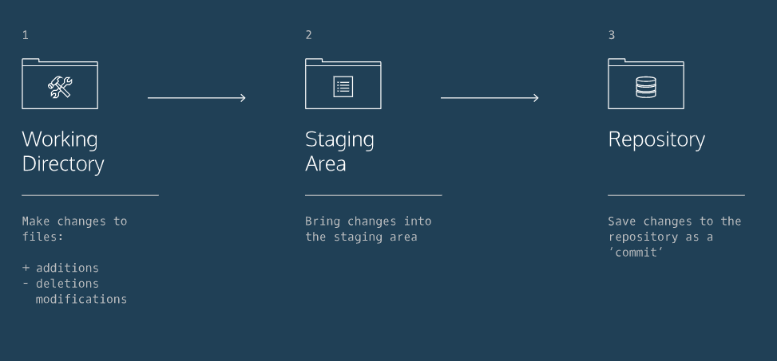
Basic Workflow

Slide 4

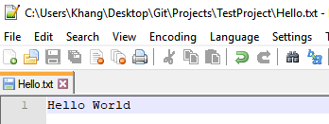
Working Directory
Where you make changes to files and do any modifications.
Usually done on your local computer
Create a repository
In your working folder create a git repository with git init
Modify files:

Slide 5

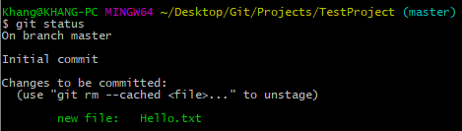
Staging Area
This is where files are added before committing to the repository.
A snapshot of the files are taken for tracking purposes.
Use the command git add <filename> to add a specific file or git add –A to track all files
Using git add:
The file status can be shown with command git status
git status:
This shows that you are on the main branch with a new file in our staging area “Hello.txt”

Slide 6


Committing to the Repository
Move items within the Staging Area to the Repository with ‘commit’
Every commit to the repository requires a message to document the changes made.
Commit with the command commit –m “Your Message Here”
git commit:
git status shows nothing left in the staging area to commit

Slide 7
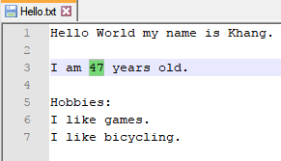
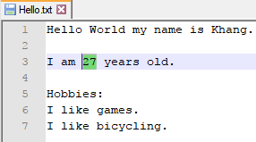
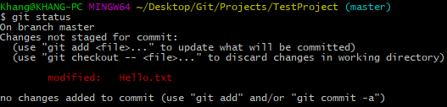
Viewing and Undoing Changes
Checking for changes within the Working and Staging area is done with command git status
My age was entered incorrectly. We change it to its correct value
Using git status we see the document was modified:

Slide 8
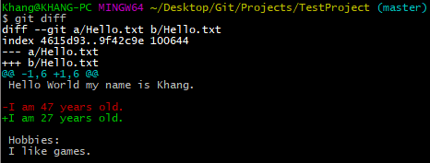
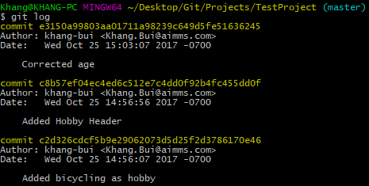
Viewing and Undoing Changes cont.
Command git diff shows the changes made from the previous status
All changes/commits that were done can be found through command git log
The green line shows the changes made. Red shows the previous entry.

Slide 9

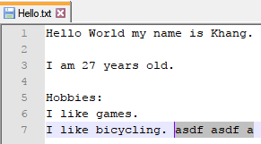
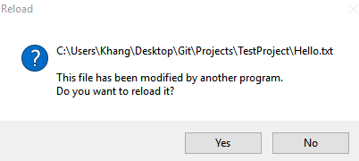
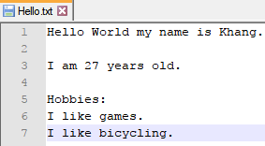
Viewing and Undoing Changes cont.
Unstage a file with git reset HEAD <filename>
Changes in the working directory can be undone with git checkout <filename>
This will revert your file back to the previous version recently committed to the repository

Slide 10

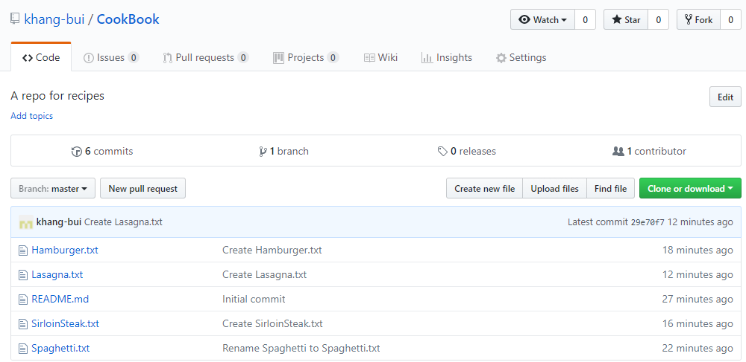
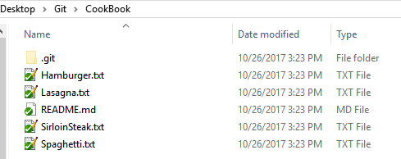
Remote Repositories
Remote repositories make collaborating on projects possible from anywhere
To copy an existing repository use git clone <Repo URL>
The local machine will now have all the files from the remote repository

Slide 11
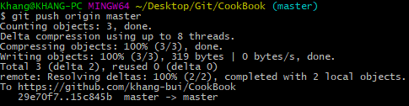
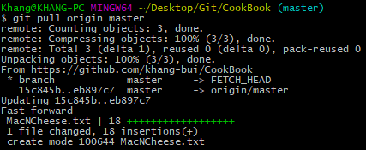
Remote Repositories cont.
Update the remote repository with local commits using git push
Update the local repository with changes made from the remote with git pull

Slide 12

Branches
Branches help isolate changes until they are ready to be merged to the master
Prevents already working versions from being broken
Different people can develop features at the same time
Other changes do not affect the branch a person is working on
Branches can be compared
The default branch of every repository is called the master. New branches can be created with ‘git branch <BranchName>’
‘git branch’ will show the available branches. The asterisk denotes the current branch

Slide 13

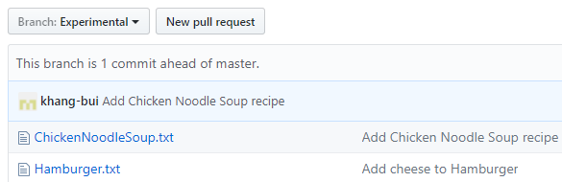
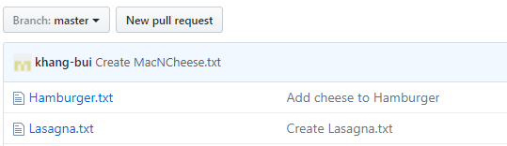
Branches cont.
Switch to a specified branch using ‘git checkout <BranchName>’
Merge branches together with ‘git merge’
We’ve added a new file ‘ChickenNoodleSoup.txt’ in the ‘Experimental’ branch
The experimental branch was pushed with the change but master does not have the new recipe yet. We will have to merge the branches together.

Slide 14


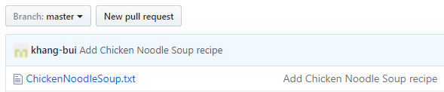
Merging Branches
First go into the branch you want your changes merged into
Use git merge <BranchName> supplying the branch name you want merged into master
After pushing the changes to our remote repository we can see that master has been updated

